Slide 1

Business Management for IT
(IT3090)
Economics
Lesson 5
站长素材 SC.CHINAZ.COM
Anupama Dissanayake
MEcon (Reading-Col.), MLRHRM (Col.), BBA (Hons) (Sheff Hallam),
PQHRM (IPM), AMIPM, MPASL

Slide 2

LEARNING OUTCOMES
At the end of the lecture, students should be able to;
Understand the basic economic concepts.
Explain the concept of demand and supply.
Identify the market structures and their characteristics.

Slide 3
Economic Concepts
站长站素材 SC.chinaz.COM

Slide 4
Needs, Wants and Resources
Need – the basic desires of the humans
Want – the different ways of satisfying needs
Factors of Production or Types of resources
Land – The gifts of nature such as land, forests, minerals
Labour – All human resources whether inherited or acquired, and could be used in production
Capital – Man made aids to further production such as tools, machinery, factories
Entrepreneurship – People who take risks by introducing new products or new ways of old products

Slide 5
Scarcity of Resources
Society has insufficient productive resources to fulfill all human wants and needs
Unlimited human needs and wants, in a world of limited resources
Scarcity implies that not all of society's goals can be pursued at the same time

Slide 6
Choice
Due to scarcity of resources, there is a choice.
Choice involves compromising between competing interests.
When people have to choose, they have to analyze the Costs and the Benefits of the choices which is known as Cost Benefit Analysis. An action should be taken if the benefits exceed its costs.

Slide 7
Basic economic questions
Since resources are limited (scarcity) and wants are unlimited, we must chose how to make optimum economic use of resources.
These choices that we make on a daily basis are attempts to solve the basic economic questions.
What to produce –
Choice of goods or services
How to produce –
Production method
For whom to produce –
Target consumers

Slide 8
Opportunity Cost
The resources are scare and they have alternative uses.
The opportunity cost is the value of the next best alternative that must be forgone to undertake the activity.

Slide 9
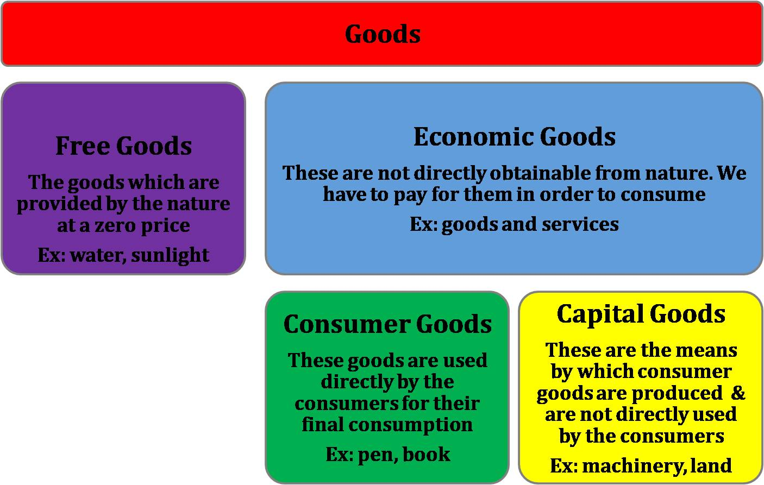
Types of goods

Slide 10
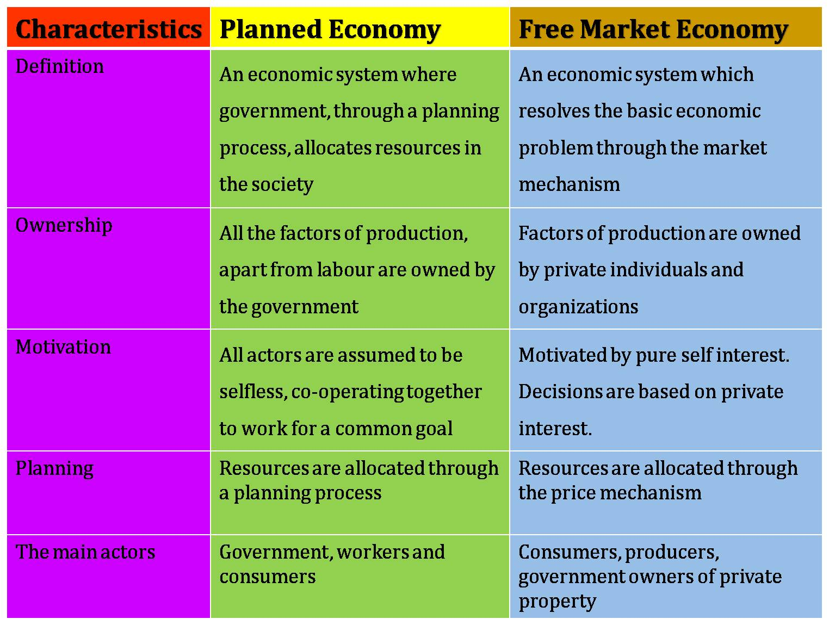

Slide 11
Demand and Supply
站长站素材 SC.chinaz.COM

Slide 12
The Assumptions
The law of demand and low of supply are based on two assumptions;
CETERIS PARISBUS –
One factor will change at one time. All the other factors remain constant.
The consumers are rational -
The buyers and supplier are aware of the conditions in the market

Slide 13
The Concept of Demand
Demand:
The quantity that people are willing to buy at a given price and during a period of time.
The term demand signifies the ability or the willingness to buy a particular commodity at a given point of time.

Slide 14
The factors that affect demand
Price of the product
Income of the buyers
Price of other goods
Substitutes
Complements
Taste and fashion
Expectation
Social reasons
Population, Gender, Age structure, etc.

Slide 15
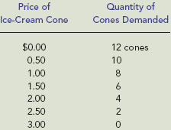
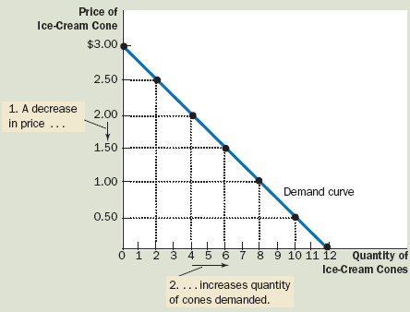
Price and Quantity Demanded: The Law of Demand
The law of demand
The negative relationship between price and quantity demanded.
As price rises, quantity demanded decreases; as price falls, quantity demanded increases.
Price
QD
Demand schedule
A table showing how much of a given product a household would be willing to buy at different prices.
Demand curve
A graph illustrating how much of a given product a household would be willing to buy at different prices.
Demand Curves Slope Downward
When price rises, quantity demanded falls, and when price falls, quantity demanded rises. There is a negative relationship between quantity demanded and price.

Slide 16
“A Change in Quantity Demand” and “Increase and Decrease in Demand”
A Change in Quantity Demand :
Occurs as a result of a change in the price.
An increase and decrease Demand :
Occurs as a result of the changes in other factors and not the price.

Slide 17
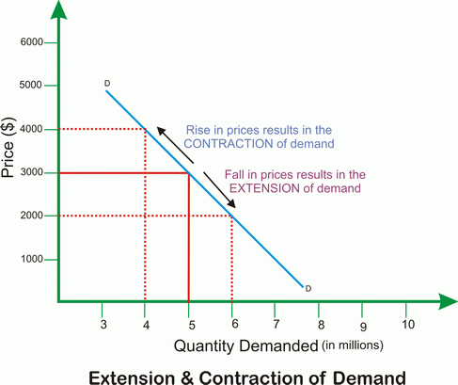
A Change in Quantity Demand
Contraction
When the prices rises, the quantity demanded will fall.
It is a movement upward along the demand curve.
Extension
When the prices fall, the quantity demanded will rise.
This is a movement downwards along the demand curve.

Slide 18
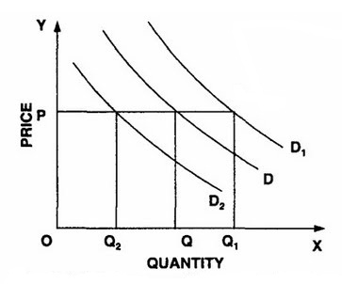
Increases and Decreases in Demand
Change in factors other than Price;
The factor affecting demand | Increase Demand |  | Decrease Demand
Taste | Increase | Increase | Decrease | Decrease
Population | Increase | Increase | Decrease | Decrease
Income | Increase | Increase demand if a normal good | Decrease | Increase demand if an inferior good.
Substitute | Increase in price | Increase | Decrease in price | Decrease
Complement | Increase in price | Decrease demand | Decrease in price | Increase demand
Expectations of the price of the product | Increase | Increase | Decrease | Decrease

Slide 19
Concept of Supply
Supply
The quantity of a product that the suppliers are willing to supply at a given price and at a given time.
The amount produced or output available or the stocks of goods available are not the supply.
The supply is the amount offered for sales.

Slide 20
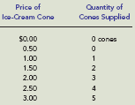
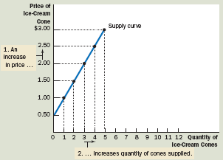
Price and Quantity Supplied: The Law of Supply
Law of supply
The positive relationship between price and quantity of a good supplied.
An increase in market price will lead to an increase in quantity supplied, and a decrease in market price will lead to a decrease in quantity supplied.
Supply schedule
A table showing how much of a product firms will sell at alternative prices.
Supply curve
A graph illustrating how much of a product a firm will sell at different prices.
Supply Curves Slope Upward
A producer will supply more
when the price of output is
higher. The slope of a supply
curve is positive.

Slide 21
“A Change in Quantity Supply” and “Increase and Decrease in Supply”
A Change in Quantity Supply :
Occurs as a result of a change in the price.
An increase and decrease Supply :
Occurs as a result of the changes in other factors and not the price.

Slide 22
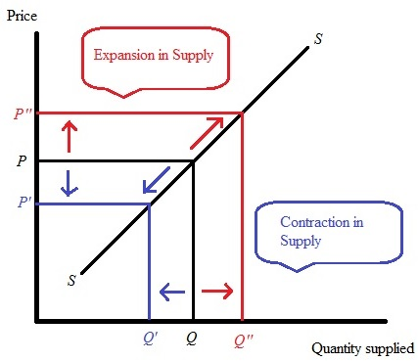
A Change in Quantity Supply
Extension
When the prices rises, the quantity supplied will increase.
It is a movement upward along the supply curve.
Contraction
When the prices fall, the quantity supplied will fall.
It is a movement downwards along the supply curve.

Slide 23
Increases and Decreases in Supply
Change in factors other than Price;
The factor affecting demand | Increase Supply |  | Decrease Supply
Technology | Increase | Increase | Decrease | Decrease
Resource prices | Increase | Decrease | Decrease | Increase
Substitute Prices | Increase | Decrease | Decrease | Increases
Expectations of suppliers | Increase | Increase | Decrease | Decrease
Government policies | Increase | Decrease | Decrease | Increase

Slide 24
Market Equilibrium
Equilibrium
The condition that exists when quantity supplied and quantity demanded are equal. At equilibrium, there is no tendency for price to change.
The operation of the market depends on the interaction between suppliers and demanders.
At any moment, one of three conditions prevails in every market:
(1) The quantity demanded exceeds the quantity supplied at the current price, a situation called excess demand;
(2) the quantity supplied exceeds the quantity demanded at the current price, a situation called excess supply; or
(3) the quantity supplied equals the quantity demanded at the current price, a situation called equilibrium.

Slide 25
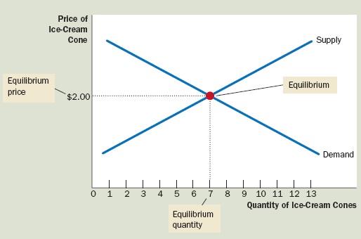
Equilibrium price
The price that balances quantity supplied and
quantity demanded
Equilibrium quantity
The quantity supplied and the quantity demanded at the equilibrium price

Slide 26
Market Structures
站长站素材 SC.chinaz.COM

Slide 27
Types of Market Structures
Perfect Competition
A Monopoly
An Oligopoly
Monopolistic Competition

Slide 28
Perfect Competition
A market in which there are many firms selling identical products with no firm large enough, relative to the entire market, to be able to influence market price.
The seller is a price taker.
Perfect competition is a theoretical market structure that will give the optimum allocation of resources.

Slide 29
Characteristics of Perfect Competition
Large number of firms.
Large number of buyers.
The product is homogeneous
No barriers to entry.
Complete information.
Profit maximization.

Slide 30
Monopoly
Monopoly is a market structure, where there only a single seller producing a product having no close substitute.

Slide 31
Characteristics of Monopoly
A single seller has complete control over the supply of the commodity.
There are no close substitutes for the product.
There is no free entry and exit because of some restrictions.
There is no competition.
Monopolist is a price maker.
Since there is a single firm, the firm and industry are one and same i.e. firm coincides the industry.

Slide 32
Monopolistic Competition
Market structure where many sellers are there who sell differentiated products and therefore have some control when it comes to pricing of their products.
Monopolistic Competition is a form of imperfect competition where many competing producers sell products that are differentiated from one another.

Slide 33
Characteristics of Monopolistic Competition
Four distinguishing characteristics:
Many sellers that do not take into account rivals’ reactions
Product differentiation where the goods that are sold aren’t homogenous
Multiple dimensions of competition make it harder to analyze a specific industry, but these methods of competition follow the same two decision rules as price competition
Ease of entry of new firms in the long run because there are no significant barriers to entry

Slide 34
Oligopoly
An oligopoly is a market form in which a market or industry is dominated by a small number of sellers.
Because there are few sellers, each oligopolistic suppliers are likely to be aware of the actions of the others.
The decisions of one firm influence, and are influenced by, the decisions of other firms.

Slide 35
Characteristics of Oligopoly
Few firms
Either standardized or differentiated products
Difficult entry

Slide 36
Thank you
站长站素材 SC.chinaz.COM

